Slide 1

Data Engineering Class 3.1 Data Engineering Best Practices
Carlos De Oliveira
(cnd279@NYU.edu)
Spring 2023

Slide 2
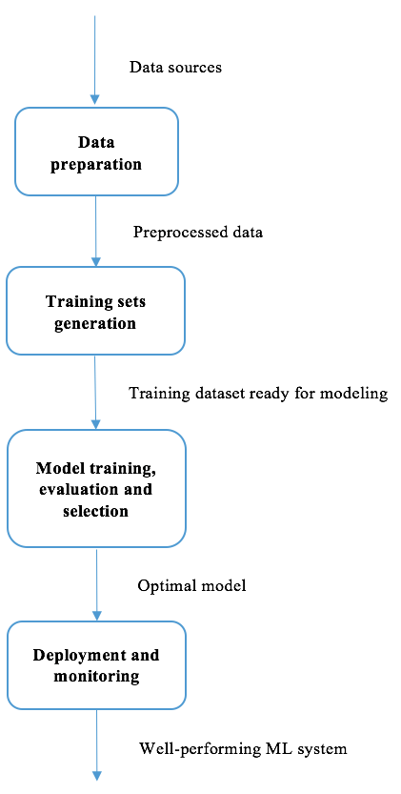
Workflow
Data Engineering
loop
Feature Engineering (BP 11)
Data Sciences
Data Engineering

Slide 3
Best practice 1: Completely understanding the project goal
Before starting to collect data, we should make sure that the goal of the project and the business problem, is completely understood, as this will guide us on:
What data sources to investigate, and
Where domain knowledge and expertise is required.
For example:
Stock Price Prediction with Regression Algorithms

Slide 4
Best practice 2: Collecting all fields that are relevant
With a set goal in mind, we can narrow down potential data sources to investigate. Now the question becomes:
Is it necessary to collect the data of all fields available in a data source, or
Is a subset of attributes enough?
It would be perfect if we knew in advance which attributes were key indicators or key predictive factors. However, it is in fact very difficult to ensure that the attributes hand-picked by a domain expert will yield the best prediction results.
Hence, for each data source, it is recommended to collect all the fields that are related to the project, especially in cases where recollecting the data is time consuming, or even impossible.
After collecting the datasets that we think are useful, we need to assure the data quality by inspecting its consistency and completeness.

Slide 5
Best practice 3: Maintaining the consistency of field values
In a dataset that already exists, or in one we collect from scratch, oftentimes we see different values representing the same meaning.
For example:
There are American, US, and U.S.A in the country field, and male and M in the gender field. It is necessary to unify or standardize values in a field → US, and M or F
In the age field, there are true age values, such as 21 and 35, and incorrect age values, such as 1990 and 1978.
Transformation and reformatting should be conducted in order to ensure data consistency.

Slide 6
Best practice 4: Dealing with missing and wrong data
Replacing missing values with mean or median value of the field across all samples, or the most frequent value for categorical data.
Discard samples containing any missing value, or discard fields containing missing values in any sample
See code

Slide 7
Best practice 5: Storing large-scale data
The goal of cross-validation is to reliably estimate generalizability, so you can tune confidently based on the estimations. The first step is adding a validation set to the training (X_train) and testingsets
The goal of cross-validation is to reliably estimate generalizability, so you can tune confidently based on the estimations. The first step is adding a validation set to the training (X_train) and testingsets
The two main strategies of storing big data are scale-up and scale-out:
A scale-up approach increases storage capacity if data exceeds the current system capacity, such as by adding more disks. This is useful in fast-access platforms.
In a scale-out approach, storage capacity grows incrementally with additional nodes in a storage cluster, , where data is spread across hundreds or even thousands of nodes.
(Examples: Apache Hadoop, AWS S3, and Google Cloud Storage.)

Slide 8
Best practice 6: Identifying categorical features with numerical values
Categorical features are easy to spot, as they convey qualitative information, such as risk level, occupation, and interests.
However, it gets tricky if the feature takes on a discreet and countable (limited) number of numerical values, for instance, 1 to 12 representing months of the year, and 1 and 0 indicating true and false.
The key to identifying whether such a feature is categorical or numerical is whether it provides a mathematical or ranking implication: if so, it is a numerical feature, such as a product rating from 1 to 5; otherwise, it is categorical, such as the month, or day of the week.

Slide 9
Best practice 7: Deciding on whether to encode categorical features
If a feature is considered categorical, we need to decide whether we should encode it.
This depends on what prediction algorithm(s) we will use.

Slide 10

Best practice 8: Deciding on whether to select features, and if so, how to do it
In between Data Sciences and Data Engineering
Detailed approach on Feature Engineering course
See code/example
(see code example)

Slide 11

Best practice 9: Deciding on whether to reduce dimensionality, and if so, how to do so
Feature selection and dimensionality are different in the sense that the former chooses features from the original data space, while the latter does so from a projected space from the original space.
However, dimensionality reduction has similar advantages to feature selection.
(see code example)

Slide 12
Best practice 10: Deciding on whether to rescale features
In most cases, an algorithm that involves any form of distance (or separation in spaces) of samples in learning requires scaled/standardized inputs, such as SVC, k-means clustering, and k-nearest neighbors (KNN) algorithms.
Feature scaling is also a must for any algorithm using SGD for optimization, such as linear or logistic regression with gradient descent, and neural networks.
That’s an important topic for the Feature Engineering course.

Slide 13
Best practice 11: Performing feature engineering with domain expertise
While domain knowledge is required, sometimes we can still apply some general tips in this category – more on the Feature Engineering course.
Examples:
1. In fields related to customer analytics, such as market and advertising, the time of the day, day of the week, and month are usually important signals.
2. In retail, information over a period is usually aggregated to provide better insights. The number of times a customer visits a store for the past three months, or the average number of products purchased weekly for the previous year, for instance, can be good predictive indicators for customer behavior prediction.

Slide 14
Best practice 12: Performing feature engineering without domain expertise
If we unfortunately have very little domain knowledge, how can we generate features?
Don't panic. There are several generic approaches that you can follow – see code.

Slide 15
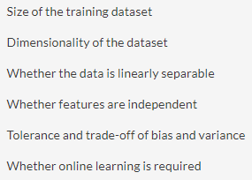
Best practice 13: Choosing the appropriate algorithm(s)
There are several things we need to be clear about before shortlisting potential algorithms:

Slide 16
Naïve Bayes
This is a very simple algorithm. For a relatively small training dataset.
If features are independent, Naïve Bayes will usually perform well.
For a large dataset, Naïve Bayes will still work well as feature independence can be assumed.
The training of Naïve Bayes is faster than other algorithms due to its computational simplicity.
However, this may lead to a high bias, but a low variance.

Slide 17

SVM
This is versatile enough to adapt to the linear separability of data.
For a separable dataset, SVM, with linear kernel, performs comparably to logistic regression.
For a high-dimensional dataset, the performance of logistic regression is usually compromised, while SVM still performs well.
In general, very high accuracy can be achieved by SVM with the right kernel and parameters.
However, this might be at the expense of intense computation and high memory consumption.

Slide 18

Random Forest (or Decision Tree)
Linear separability of data does not matter to the algorithm
And it works directly with categorical features without encoding → ease of use
Also, the trained model is very easy to interpret and explain
It might lead to overfitting by grouping a collection of separate trees
It performs comparable to SVM, while fine-tuning is less difficult

Slide 19

Neural networks
These are extremely powerful, especially with the development of deep learning.
However, finding the right topology (layers, nodes, activation functions, and so on) is not easy, not to mention the time-consuming model of training and tuning.
Hence, they are not recommended as an algorithm to start with.

Slide 20

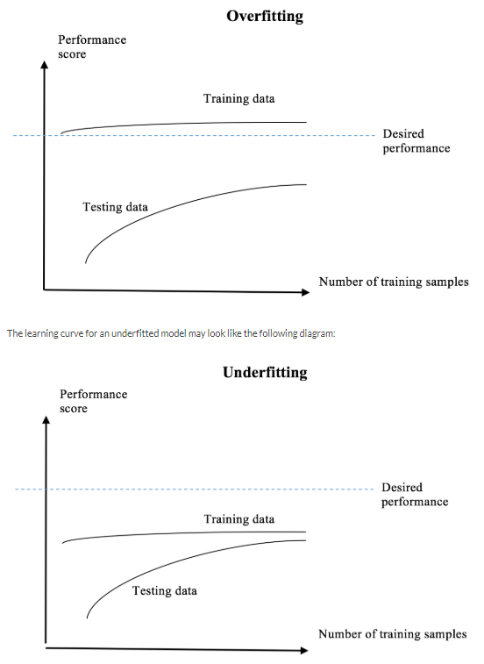
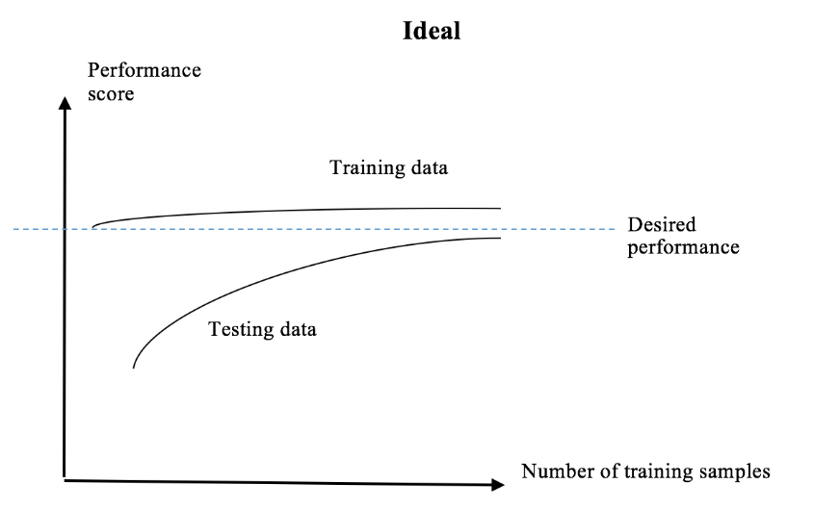
Best practice 14: Diagnosing and correcting over and underfitting

Slide 21
Best practice 14 (continuation): Diagnosing and correcting over and underfitting
Cross-validation over different datasets and techniques.
Regularization: It adds penalty terms to reduce the error caused by fitting the model perfectly on the given training set.
Simplification. The more complex the model is, the higher chance of over or underfitting.

Slide 22

Best practice 15: Modeling on large-scale datasets
First, start with a small subset, for instance, a subset that can fit on your local machine. This can help speed up early experimentation.
Second, choose a scalable algorithms, such as logistic regression, linear SVM, and SGD-based optimization. This is quite intuitive.
Third, once you figure out which model works best, you can fine-tune it using more data points and eventually train on the entire dataset.

Slide 23
Best practice 16: Saving, loading, and reusing models
In many cases, we simply cannot rerun the entire process and retrain the model every time new data comes in.
Instead, we should save the established preprocessing models and trained prediction models after corresponding stages have been completed.
In deployment mode, these models are loaded in advance, and are used to produce the prediction results of the new data.
See code

Slide 24

Best practice 17: Monitoring model performance
The machine learning system is now up and running.
To make sure everything is on the right track, we need to conduct a performance check on a regular basis.
To do so, besides making a prediction in real time, we should log the performance and set an alert for a decayed performance.

Slide 25
Best practice 18: Saving, loading, and reusing models
When machine learning is deployed, new data should go through the same data preprocessing procedures (scaling, feature engineering, feature selection, dimensionality reduction, and so on) as in previous stages.
The preprocessed data is then fed in the trained model. We simply cannot rerun the entire process and retrain the model every time new data comes in.
Instead, we should save the established preprocessing models and trained prediction models after corresponding stages have been completed.
In deployment mode, these models are loaded in advance, and are used to produce the prediction results of the new data.

Slide 26
Q&A
The floor is open to your questions

